Slide 1
Emergency Evacuations: Multi-Level Apartments
Staff and Volunteer “Fire Warden” Training
Resource developed by
Travis County Emergency Services District 2
for Self-Guided Training Purposes

Slide 2
Overview of Today’s Training
Importance of Having and Practicing an Emergency Evac. Plan
Fire Dangers and Characteristics
Fire Safety Systems and Design Features of this Facility
Basic Functions of Volunteer Fire Wardens PRIOR to an Alarm
Overview of this Facility’s Emergency Evacuation Plan:
Items Only for Staff
Items for Staff and Volunteer Fire Wardens
Steps Staff & Fire Wardens Should Take DURING a Fire Alarm
Visit a wing of an upper floor for visuals and scenarios
Next Steps to Prepare for Upcoming Fire Drill!

Slide 3
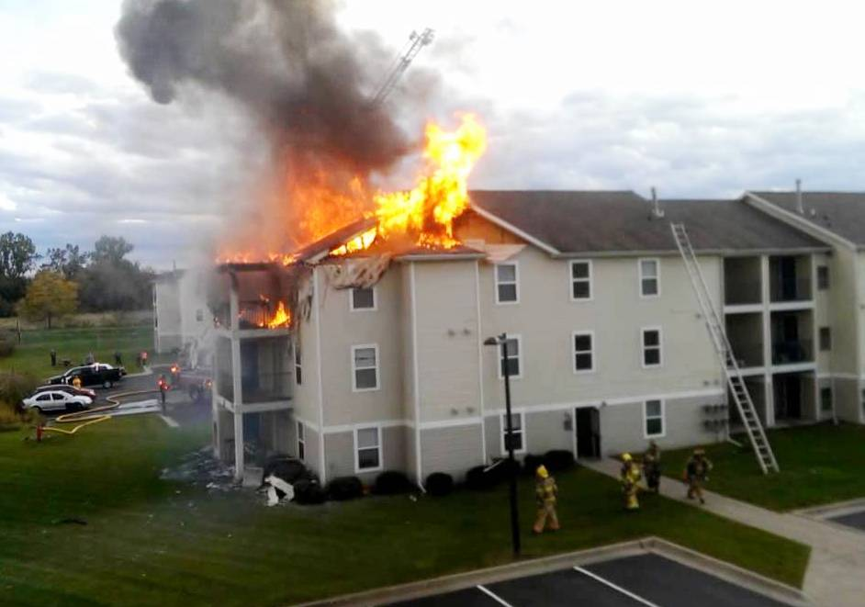
Importance of Having and Practicing a Plan
Required by Fire Code
Section 404 of the International Fire Code covers Fire Safety & Evacuation Plans. The International Fire Code requires that this facility holds some type of evacuation drill four times a year (405.2). The plan must be reviewed by management for any necessary updates at least once a year. Employees must be trained on the evacuation plan when they are hired and again at least once a year, with a record confirming. The plan must include an emergency evacuation for each dwelling unit. A diagram depicting two evacuation routes must be posted at every egress door.
WHY is it important…
to have a plan?
to review the plan?
to practice the plan?
?

Slide 4
Fire Dangers and Characteristics
Flame
Heat
Smoke
Suffocation
Toxic Gases and Vapors

Slide 5
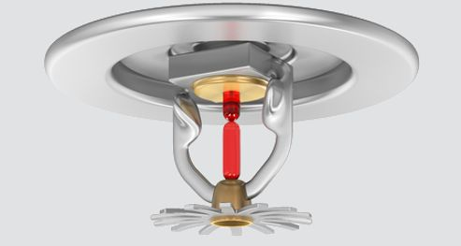
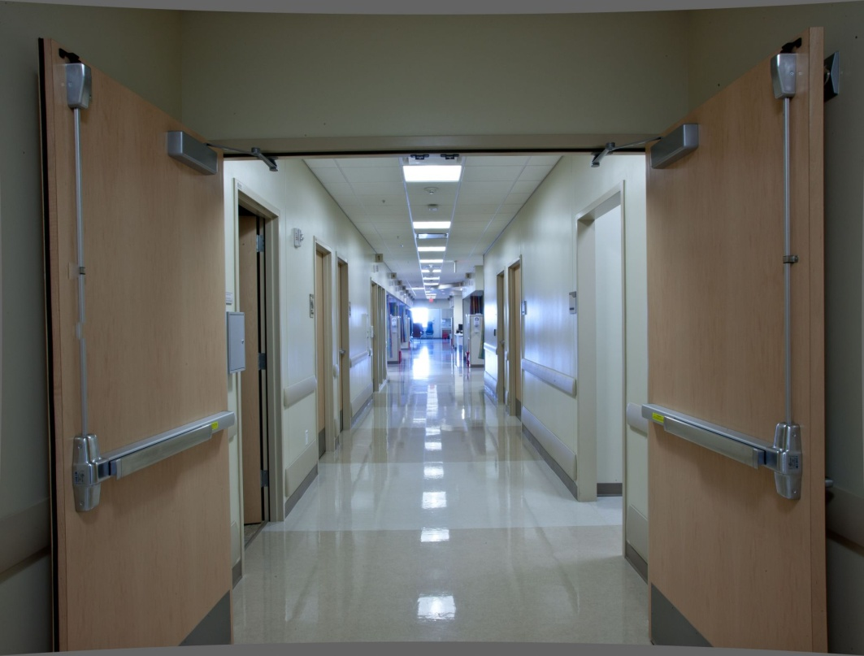
Fire Safety Systems and Design Features of this Facility
**as applicable!**
Unit Smoke Detectors
Fire Sprinkler System
Fire Alarm System
Manual Pull Stations
Unit Self-Closing, Fire-Rated Doors
Building Self-Closing, Fire-Rated Doors
(Ability to horizontally evacuate)
Areas of Refuge (Stairwells)
Multiple Paths of Escape/Egress
Emergency Back-Up Power
Lighted Exits

Slide 6
Basic Functions of Volunteer “Resident Fire Wardens”
PRIOR to a Fire Alarm
Be a positive role model for fire safety and preparedness!
Stay vigilant to spot potential fire hazards on your wing/floor. Work with Management as needed.
Ensure all neighbors on your wing/floor (including newcomers!) know who their wardens and assistant wardens are.
Review with them generally where to go (escape routes, areas of refuge, and exterior staging areas) and what to do in case of fire.
Keep handy a printed copy of the Evacuation Plan and review it frequently. With this, keep the list of residents on your wing/floor that should be provided to you by management.

Slide 7
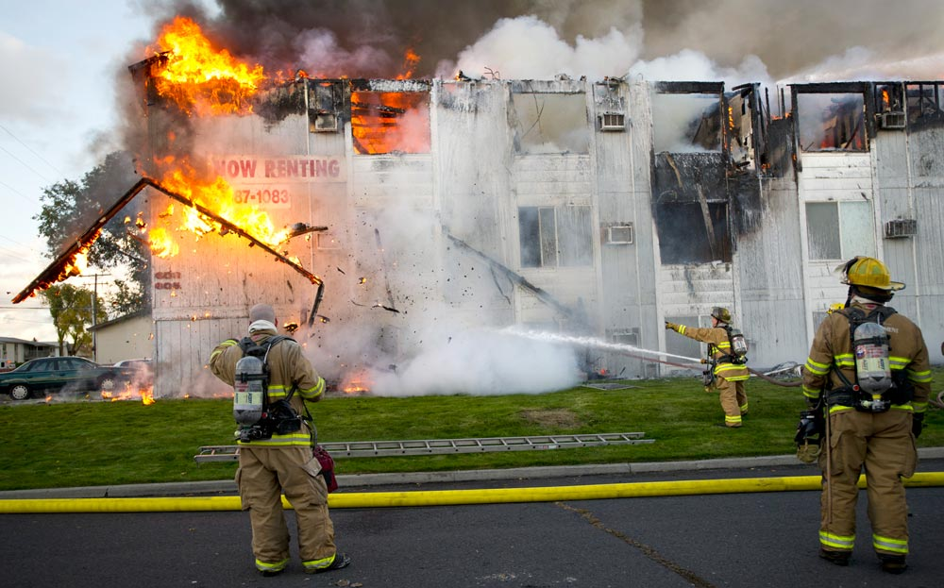
Overview of this Facility’s Emergency Evacuation Plan:
ITEMS FOR STAFF
Current list of all employees with contact information
Fire Safety Director and Assistant Director(s) identified
Outline and assignment of procedures for critical equipment (PA system if applicable, fire alarm panels, manual pulls, fire extinguishers, flammable materials storage, etc)
Agreements in place for any off-site shelter and emergency transportation, if applicable
If applicable, staff procedures for assisted rescues.
If applicable,
list of staff knowledgeable
in CPR and/or First Aid;
location of AED’s and supplies

Slide 8
Overview of this Facility’s Emergency Evacuation Plan:
ITEMS FOR STAFF and RESIDENT FIRE WARDENS
Procedure for reporting a fire/emergency to first responders
Procedure for notifying occupants of an emergency (fire, haz mat, tornado, etc)
Escape routes for all floors of all buildings/wing, per map and signs.
Interior areas of refuge for all floors of all buildings, per map and signs.
List of occupants who may require rescue assistance and their type of impairment, per building/wing and floor.

Slide 9
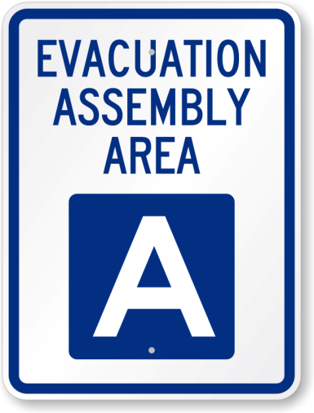
Exterior staging (assembly) area, per map and signs
Procedure to account for all staff
Procedure to account for all residents … including role of Volunteer Resident Fire Wardens

Slide 10
Steps Staff and Resident Fire Wardens Should Take DURING a Fire Alarm
If there is a fire or the alarm sounds, immediately take action!
Get your Evacuation Plan list and marker, phone, vest
Check your door for heat or signs of smoke, then exit your own unit IF safe to do so. (If not, SHELTER IN PLACE and call 9-1-1.)
Knock on the doors of your neighbors, alert them to evacuate.
Verify that the stairwell (area of refuge) is clear of smoke/danger.
Calmly direct neighbors to the closest exit and/or the area of refuge.
Provide assistance if possible to refuge area for impaired neighbors. If this isn’t possible, notify 9-1-1 of their location.

Slide 11
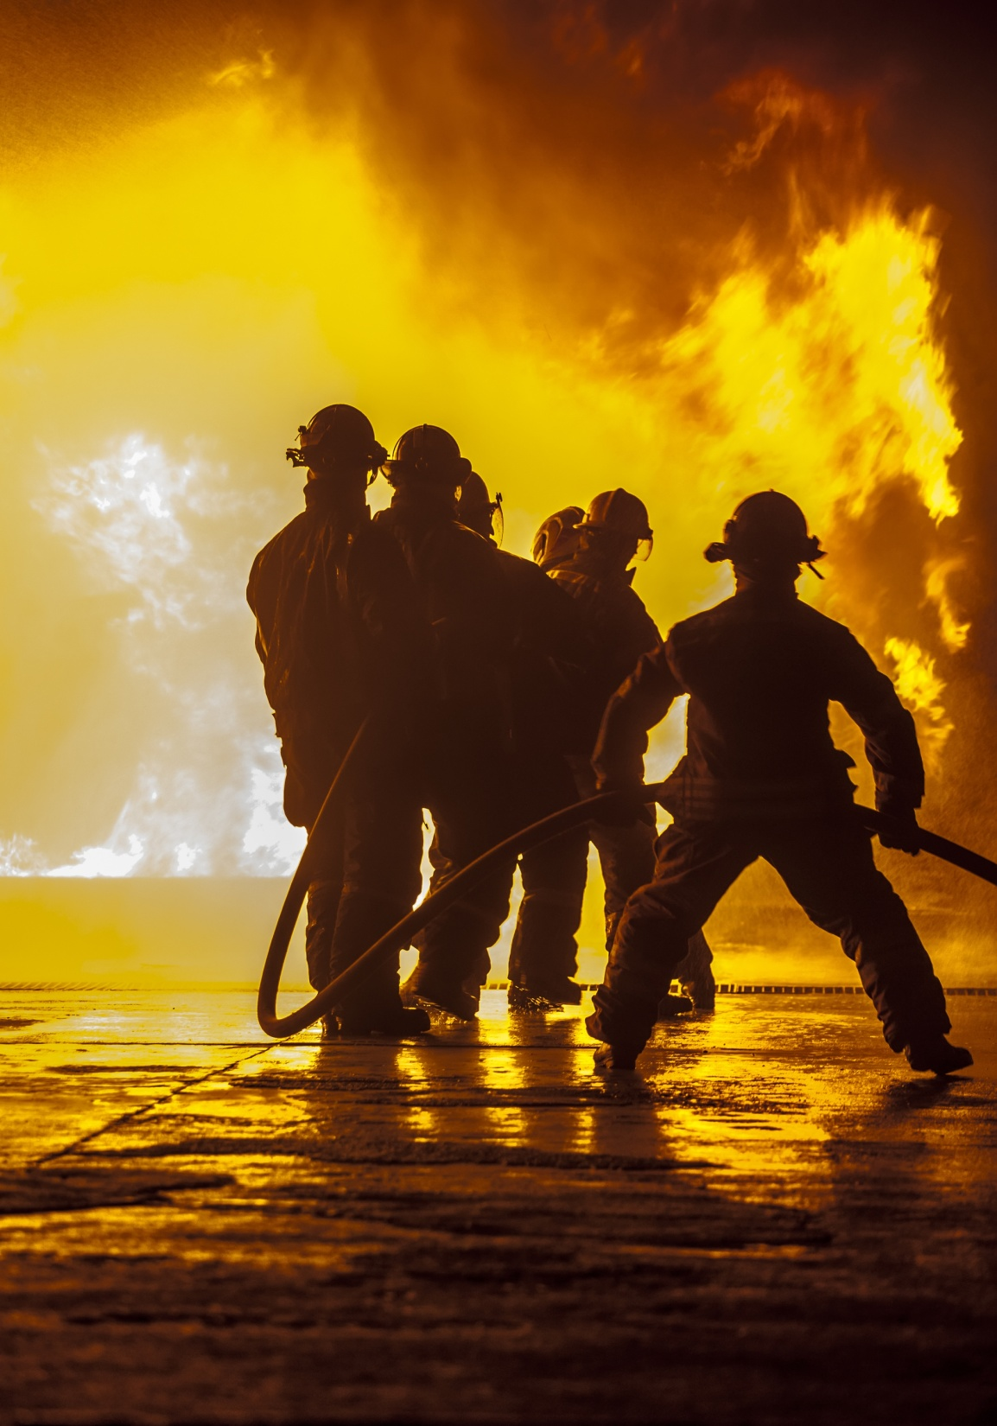
Elevators should NEVER be used in a fire / emergency except when the elevator is under the direct control of Fire Dept.!
At the interior area of refuge, perform a head count and mark your list of residents IF fire is not nearby. … If you are in the vicinity of the fire, begin guiding an orderly escape down/out to an exterior staging area and THEN account for residents.
Monitor the stairwell as your residents evacuate down/out, and maintain a calm and orderly flow to the RIGHT side of the stairwell.
Once outside at staging area, find a staff person or firefighter and tell them who isn’t accounted for and/or who needs help. Provide them with any info you have about condition of your floor.

Slide 12
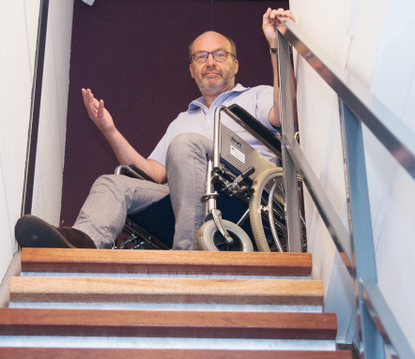
Anticipating issues during a drill or an actual emergency
How will staff communicate with each other in an emergency?
How do we decide whether to advise residents of a particular wing or floor to “shelter in place” or evacuate?
What if a resident refuses to evacuate their unit?
What if a resident needs rescue assistance (i.e. mobility issues)… where and how should they stage?

Slide 13
Emergency Evacuation / Fire Drills
This facility will conduct a basic (limited) Emergency/Fire Drill within the next few weeks. We do not anticipate that all buildings will actually be evacuated.
The date will be shared with all residents. But please keep the exact time and other details confidential, only for staff and volunteer resident fire wardens!
We will let the Fire Department know about our drill as a courtesy, but they will not be on site. We are responsible for our own drills.
As we do these drills in the future, we’ll try to vary the time of the drill and other details (such as the “fire” location).

